Slide 1
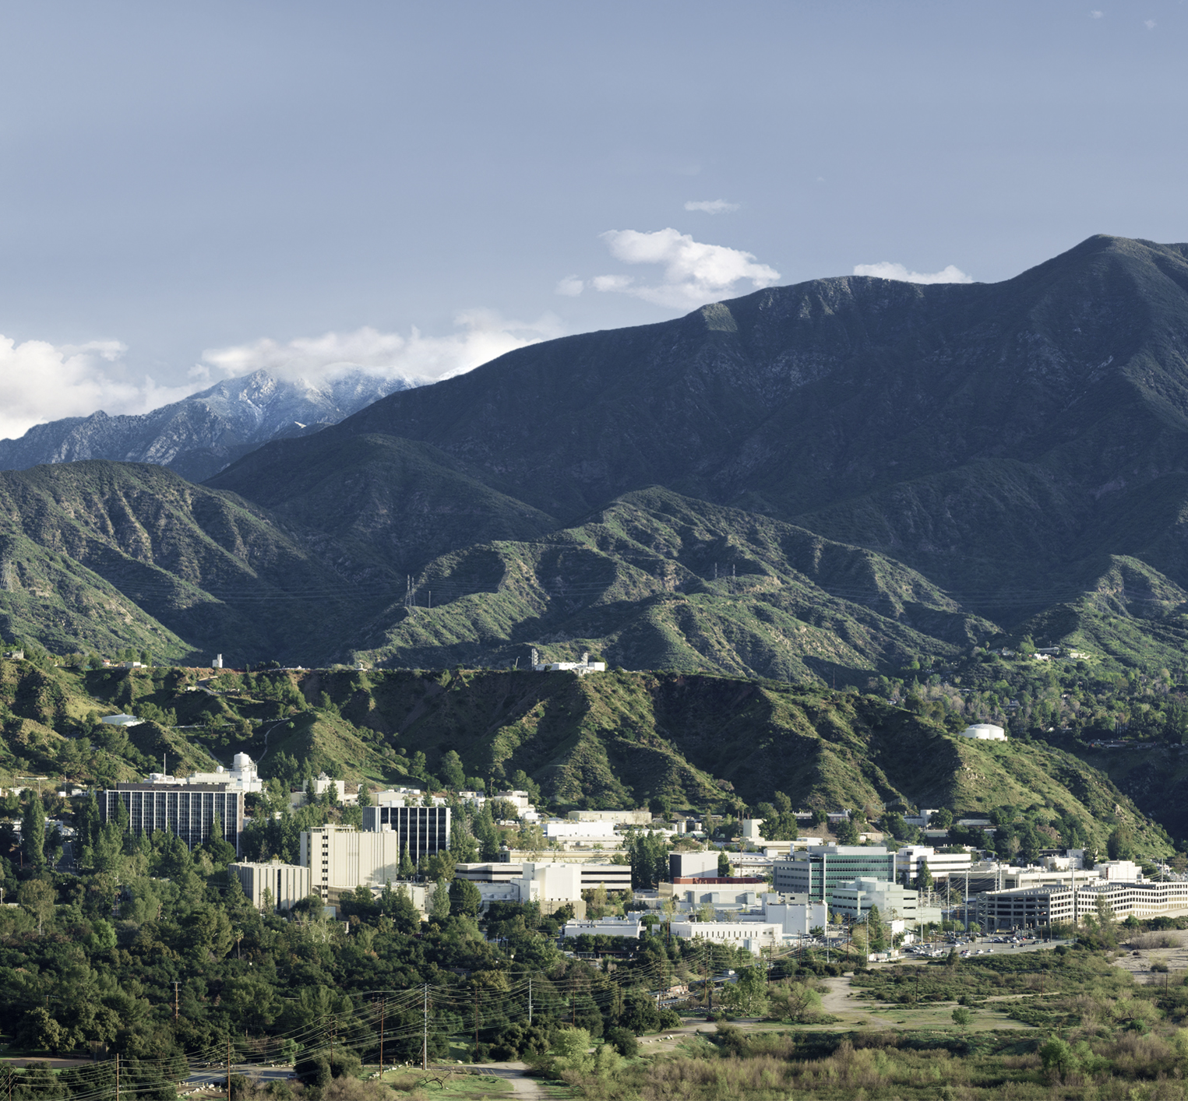
AMMOS SmallSat Toolkit Configurator and AI4CMA
Nick Bukovec
174 | AI, Analytics and Innovation Development Organization
Mentors: Chris Mattmann, Wayne Burke, and Amanda Towler
August 17th, 2022

Slide 2
Abstract
The Advanced Multi-Mission Operations System (AMMOS) is a collection of ground data system (GDS) software that is used within and outside of NASA for mission operations and data analysis. Select pieces of AMMOS, specifically for class C and D missions, have been open-sourced and can be deployed into the cloud with an Amazon Web Services (AWS) Quick Start. The AMMOS SmallSat Toolkit (AST) Configurator is a web application that determines what software a user needs from a set of forms they fill out. The tool guides the user through necessary configuration steps before creating a file that can be read into AWS to deploy infrastructure and applications in a virtual private cloud.
The United States Geological Survey (USGS) is responsible for surveying critical mineral resources on our lands. Artificial intelligence and machine learning can speed up the manual process of extracting data from maps. Creating data science challenges can advance this research. Researchers compete for a cash prize to solve common problems in georeferencing, georectification, and legend feature extraction. Challenges must be constructed and executed properly to meet the goals of USGS.

Slide 3
AST Configurator
Advanced Multi-Mission Operations System (AMMOS)
Ground data system software
Widely used
Lengthy deployment
AMMOS SmallSat Toolkit on AWS
Goal: guide user through setting up AST, produce configuration for AWS
Public web-based tool
Easy to use, easy to modify

Slide 4
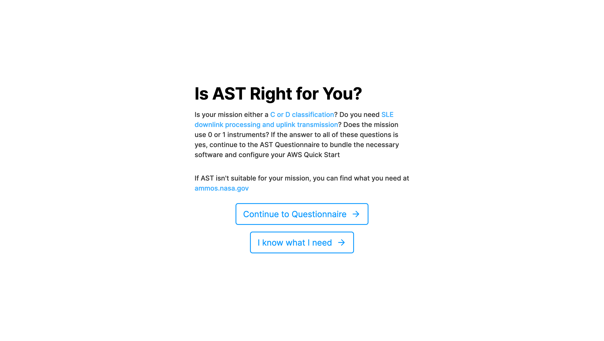
AST Configurator

Slide 5
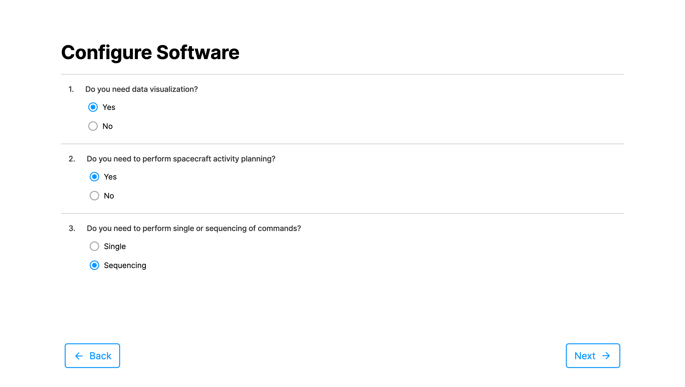
AST Configurator

Slide 6
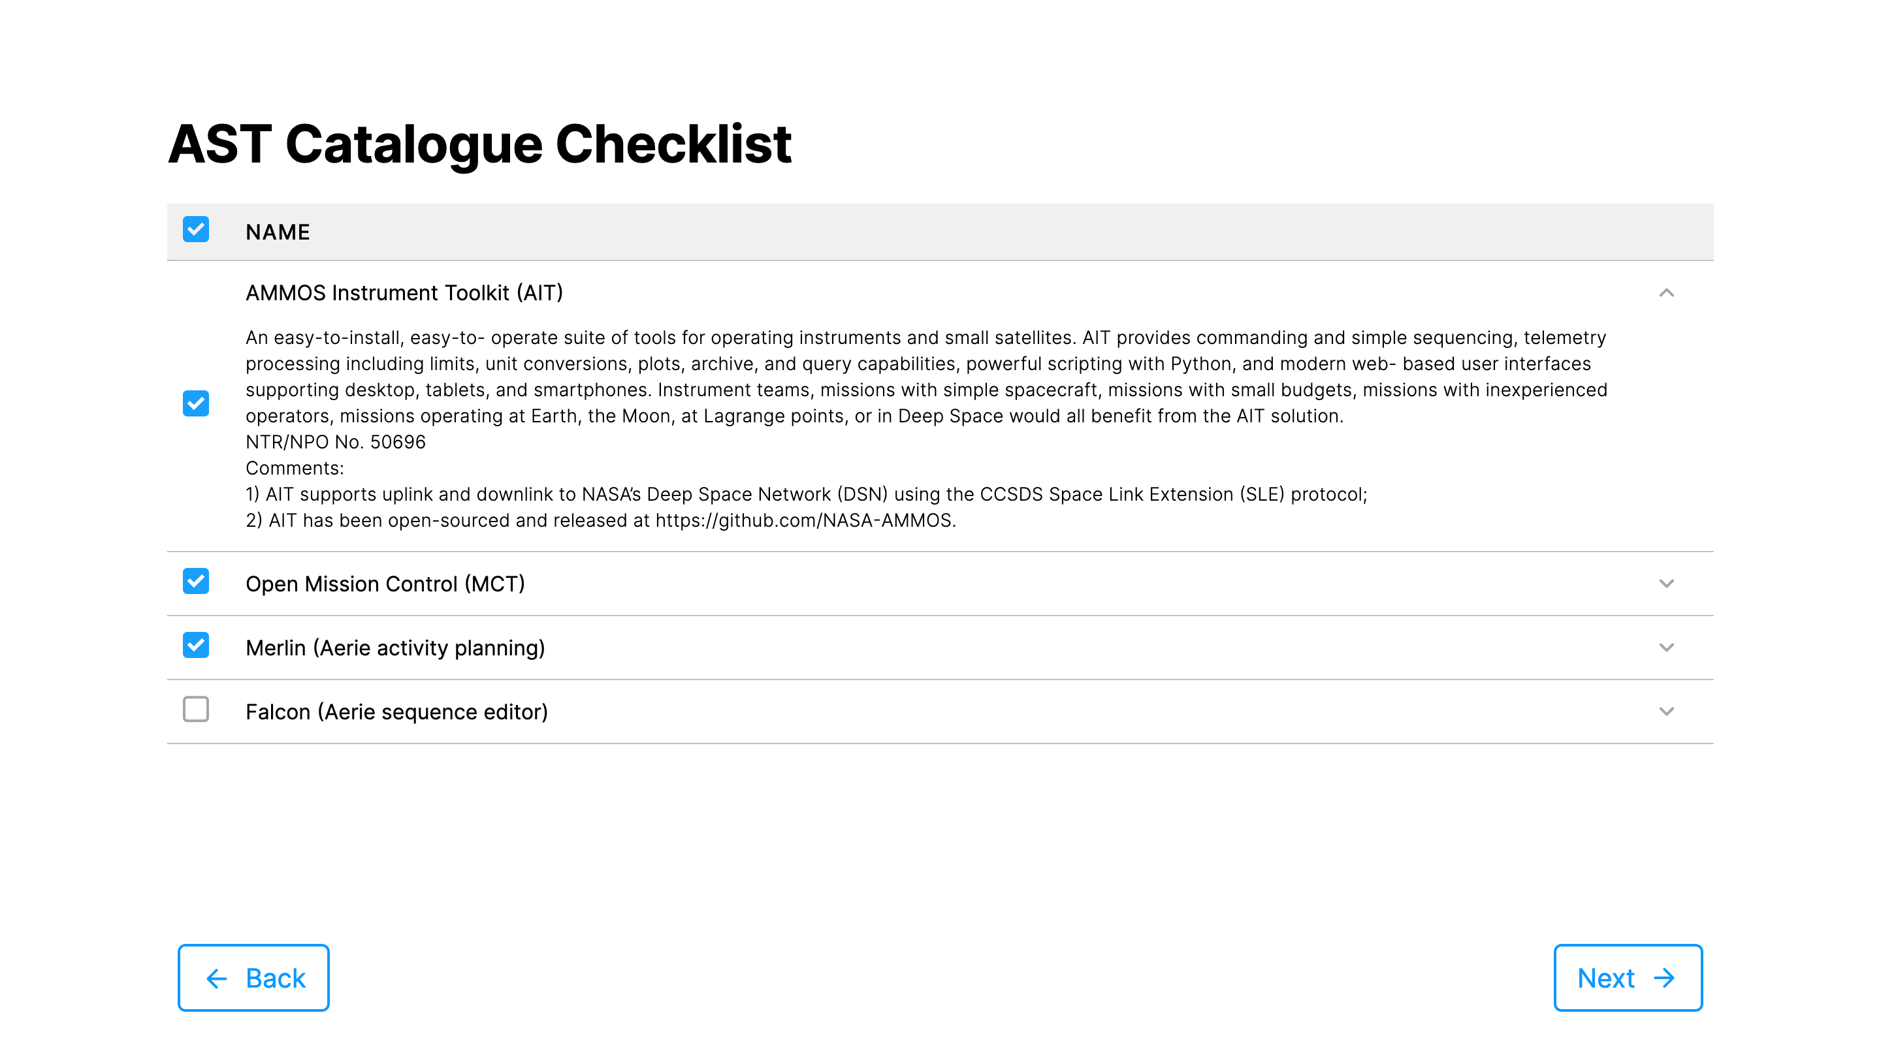
AST Configurator

Slide 7
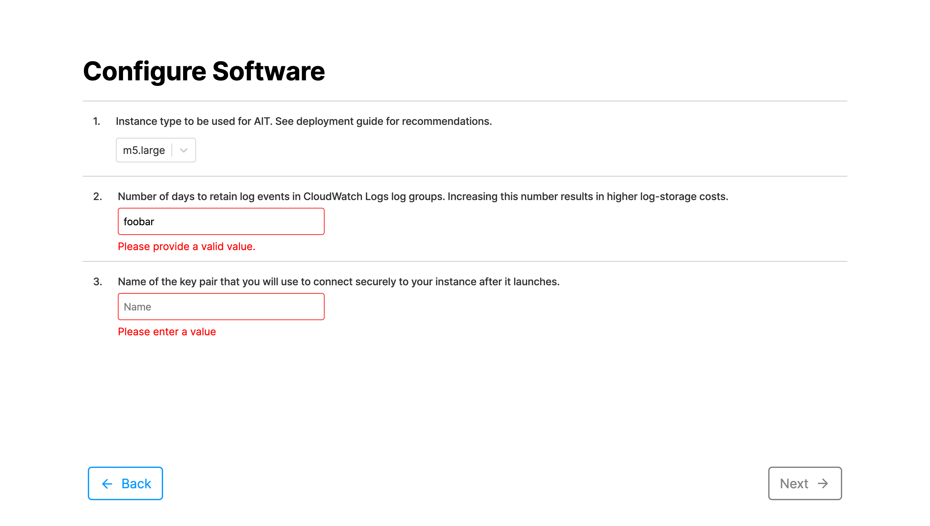
AST Configurator

Slide 8
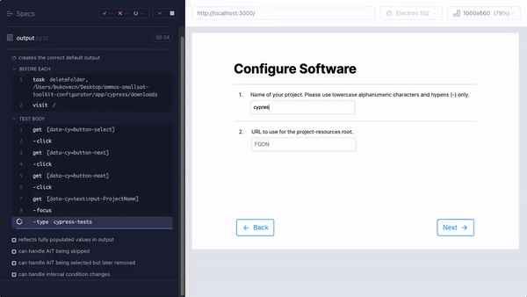
AST Configurator

Slide 9
AST Configurator
Static web application built with React and NextJS
Customizable
Section JSON files
Screen and group configuration
Creates output file
Ingested into AWS
Saves time on both sides
Easier access for non-NASA users

Slide 10
AI4CMA
USGS critical mineral survey
Implications for health of economy
Currently manual
Would take > 10yrs
MITRE identified extracting data from maps as a bottleneck
Goal: improve data extraction from maps through open data science challenges

Slide 11
AI4CMA
Automated Intelligence for Critical Mineral Assessment Challenges
Georectification (ongoing) and Legend Feature Extraction (August 29th)
Required dry runs and testing to ensure success
Creating testing scripts and helping where needed

Slide 12
AI4CMA
Created Python scripts for:
Extracting data from HTML table of links
Assembling a perfect submission file from validation ground truth
Validating data from S3 buckets
Researched current state-of-the-art
Evaluated current approaches based on effectiveness and level of automation
Ensured smooth rollout + execution

Slide 13

The Summer
Innovation Trailer
SFOF Tour
“Meeting Spot”
Professionally posing at the center of the universe

Slide 14
Acknowledgements
Mentor Chris Mattmann
Co-mentors Wayne Burke and Amanda Towler
Michael Fedell and Christiahn Roman
Div 174 & the Innovation Trailer

